Slide 1





HCDR Final Project
Group Number: 3
Team Name: FP_Group_3
Alicia Aaholm
Nicholas Chappell
Jaden Costa
Katia Torres Sanchez
Notes:
Purpose, the problem, the methods, the results, conclusion
-- a title slide (with the project name, Group Number, the team member names, and photos). -- Make sure it has an outline slide with good descriptive section headings -- Team names, photos -- Project description -- Some summary visual EDA -- Feature engineering and Top features -- Overview of Modeling Pipelines explored -- Results and discussion of results (Accuracy, ROC/AUC, Kaggle scores, Kaggle submission Screen shots, etc.. from this phase and previous phases) -- Conclusions (best performing model, number of features, top 10 best features, hyper-parameters) and next steps

Slide 2
Outline
Project Description
Project Methods
Results and Discussion
Conclusion

Slide 3
Project Description
The purpose of the HCDR project model is to train a model to predict whether a lender would be able to pay off a loan.
Allow lending institutions to make smarter business decisions
Preventing however many hundreds or thousands of dollars from being lost due to poor investments.
Notes:
puprose, the problem, the methods, the results, conclusion

Slide 4

Project Methods: Summary EDA
Training set size: 222,176 rows, 14 features
Validation set size: 46,127 rows
Test set size: 39,208 rows
Kaggle test data size: 48,744 rows
Notes:
-- Some summary visual EDA -- Feature engineering and Top features -- Overview of Modeling Pipelines explored

Slide 5

Project Methods: Feature Engineering
Best Performing Model:
Ensemble (LightGBM + CatBoost) - highest ROC-AUC score (0.7526)
Number of Features: 14
Best Features:
Engineered RFM features (e.g., loan Frequency, Monetary, Recency — shown earlier in notebook) - All three features have had a steep decline in importance in more recent runs potentially due to weighted differences in seed shuffling.
One-Hot-Encoded categorical attributes
Numeric baseline features
Hyper-Parameter Characteristics:
LightGBM and CatBoost were run with standard or lightly-tuned defaults
No evidence of grid search or Bayesian tuning appears in Phase 4
Ensemble uses soft voting with equal weights (1, 1)
Moderate Learning Rate of 0.05
Constrained Complexity: num_leaves = 31, this restricts individual tree complexity (Helpful for tabular data)

Slide 6
Project Methods: Modeling Pipelines
Multiple models were trained and compared including LightGBM and Random Forest.
Feature preprocessing was handled through a pipeline with separate numerical and categorical branches.
One-Hot Encoding expanded categorical feature space, requiring reconstruction of final feature names for interpretability.
Notebook notes emphasize: “The Ensemble and two models have added features so the Ensemble Model is technically the best overall performer.”

Slide 7
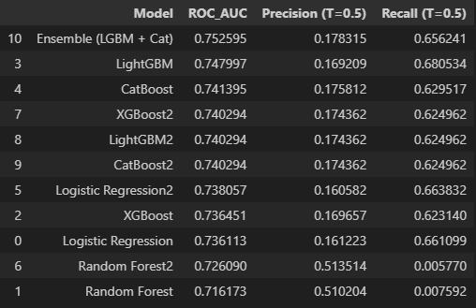
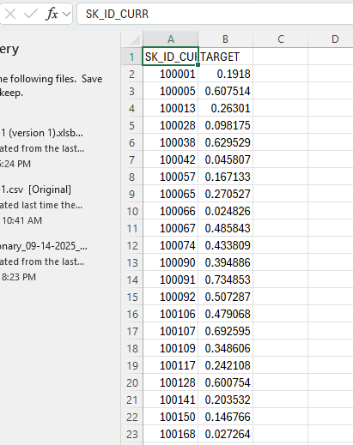
Results and Discussion
ACCURACY:
Accuracy was not the primary metric due to dataset imbalance
Ensemble and gradient boosting models showed the best balance of precision and recall.
ROC/AUC:
Ensemble (LightGBM + CatBoost): 0.7526 (best overall)
LightGBM: 0.7480
CatBoost: 0.7414
XGBoost2: 0.7403
KAGGLE SCORE:
The Kaggle score was consistent with the model’s overall performance indicating stable generalization on unseen data.
Notes:
-- Results and discussion of results (Accuracy, ROC/AUC, Kaggle scores, Kaggle submission Screen shots, etc.. from this phase and previous phases)

Slide 8
Conclusion
Best Performing Model: Ensemble (LGBM + CAT) ;ROC_AUC= .75
Number of Features: 57(After OHE+previous application features)
Top 10 Best Features: CODE_GENDER_M, EXT_SOURCE_3, NAME_EDUCATION_TYPE_Higher EDUCATION, EXT_SOURCE_2, CODE_GENDER_F, NAME_INCOME_TYPE_Pensioner,NAME_CONTRACT_TYPE_Cash loans, FLAG_OWN_CAR_N,NAME_INCOME_TYPE_Working, NAME_EDUCATION_TYPE_Secondary / secondary special
Hyper-Parameters: LightGBM when tuned, achieved a peak AUC of ~0.7454 in contrast to the Deep Learning Model achieveing 0.7448(No hyperparameters). This shows that engineered features where most likely a primary driver in both models for performance.
Notes:
Conclusions (best performing model, number of features, top 10 best features, hyper-parameters) and next steps

